Slide 1
Second Day Progress

Slide 2
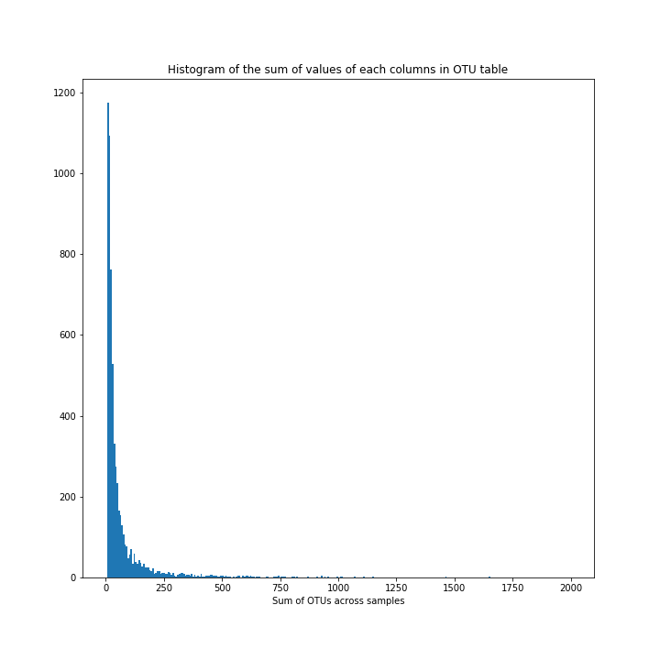
Feature Selection
After filtering OTU >= 10 total counts across samples, the number of OTUs reduced from 17,544 to 6,258

Slide 3
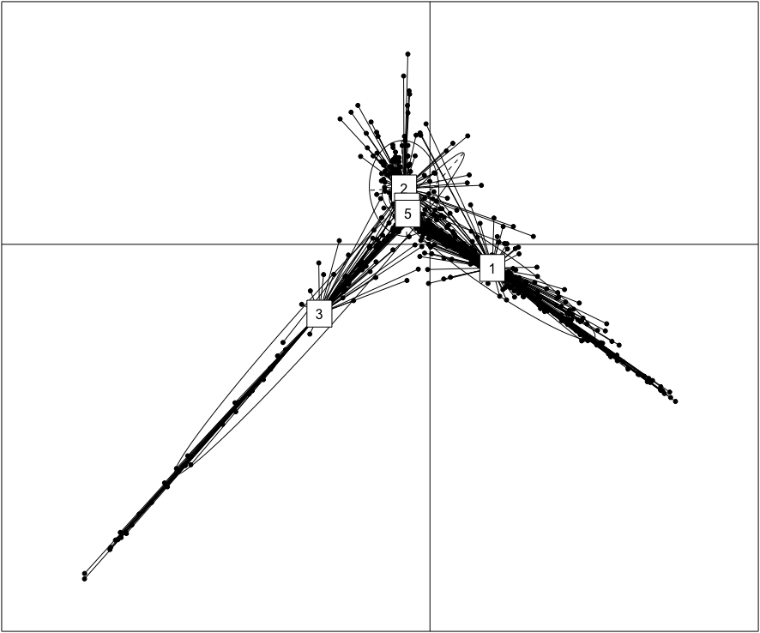
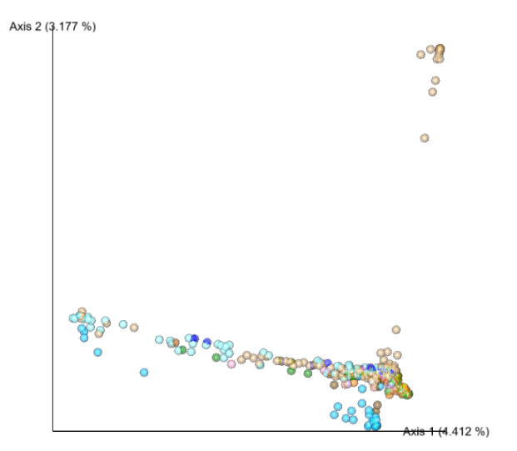
Clustering with based on relative genus abundances using JSD distance and the Partitioning Around Medoids (PAM) clustering algorithm
Butterflies
#2 - Bats
#5 - Butterflies
Bats

Slide 4
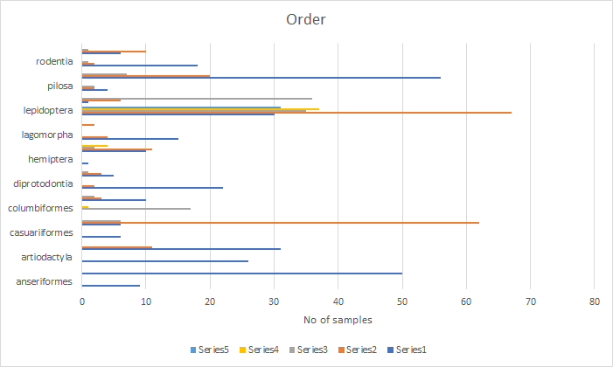

Slide 5
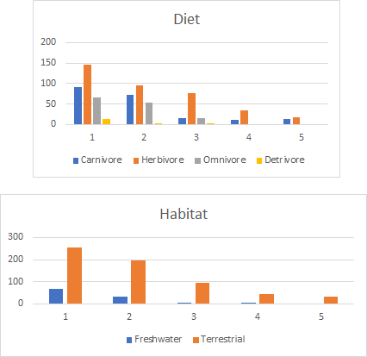

Slide 6
